Slide 1
DRS Proposal Presentation
Group B

Slide 2
Introduction
Racetrack layouts are created with many twists and turns as well as straights to create exciting racing.
Teams must create an aero package that best works for the track.
A rear wing creates high downforce for the rear of the car but produces a lot of drag on straights.
DRS can be implemented to combat this.
Opens rear wing to reduce as much drag as possible.
Finding the right balance between downforce and weight is difficult
Can be found through designing and testing within regulations
To develop our understanding, we will use JavaFoil and Solidworks to develop our DRS profile.
To aid our research, we used several development reports published by various universities.

Slide 3
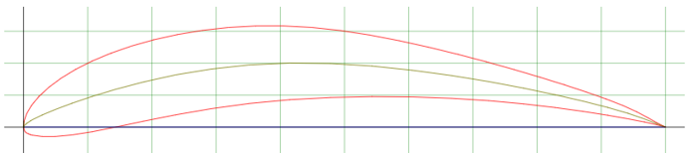
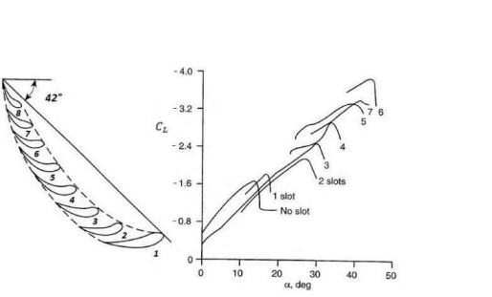
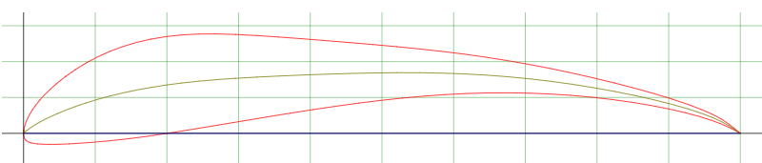
Aerofoil Design Optimisation
E423 Aerofoil
Factors for Aerofoil Optimisation:
Number of Elements
Aerofoil Profile
Gap
Angle of Attack
S1223 Aerofoil

Slide 4
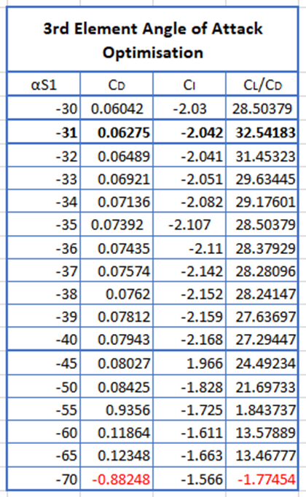
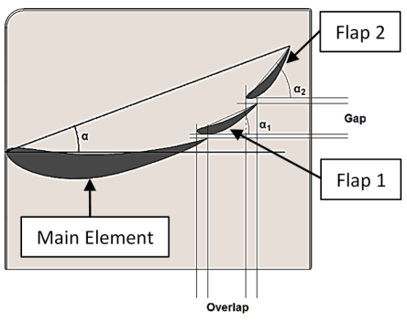
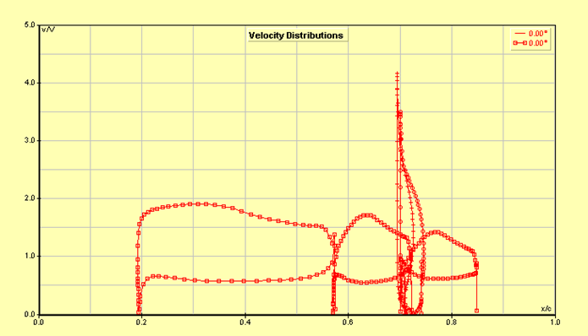
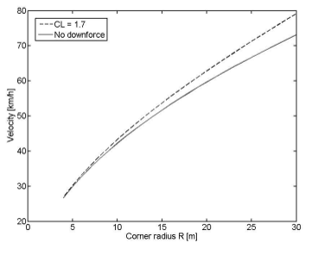
Aerofoil Design Optimisation
Target Drag & Lift Coefficient Values:
-1.5 > CL > -4 - whilst ensuring that no flow separation occurs
CD < 1.747 - ideally as small as possible while maintaining a reasonable lift coefficient
307.94c Main 123.18s Flaps
Suggested Gap Values:
x 1% to 6% *c y 1% to 4% *c
Suggested Angles of Attack:
Flap 1: 25 to 30
Flap 1: 30 to 70

Slide 5
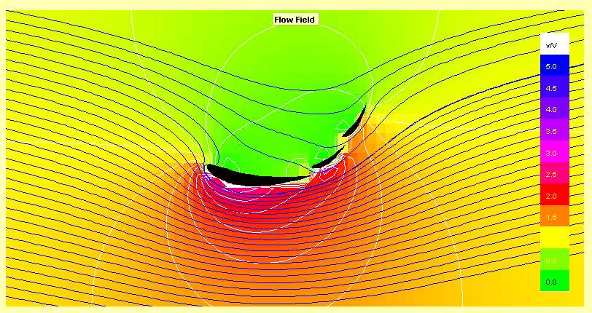
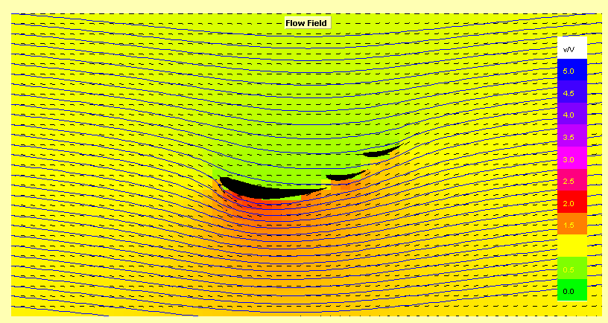
DRS closed (v/V) lift coefficient of -2.009 and drag coefficient of 0.06652
Angles of Attack
Main Element 6°
Flap 1 -26°
Flap 2 -31°
DRS Open (v/V) lift coefficient of -1.415 and drag coefficient of 0.03109
Angles of Attack
Main Element 6°
Flap 1 0°
Flap 2 0°

Slide 6
Materials, Manufacturing and overall Design
Aerofoil: Carbon fibre - increased strength and rigidity
Endplates: Carbon fibre - light
Swan neck mounts: Carbon fibre - increased strength
Manufacturing methods for carbon fibre:
Molds are constructed using vacuum forming or 3D printing for smaller components. Hollow inside, upper and lower surfaces constructed separately then glued together and bolted to end plates which are sandwiched with a stiff polymer or aluminium sheet. Wet lay up is the most simple process and does not require expensive machinery.

Slide 7
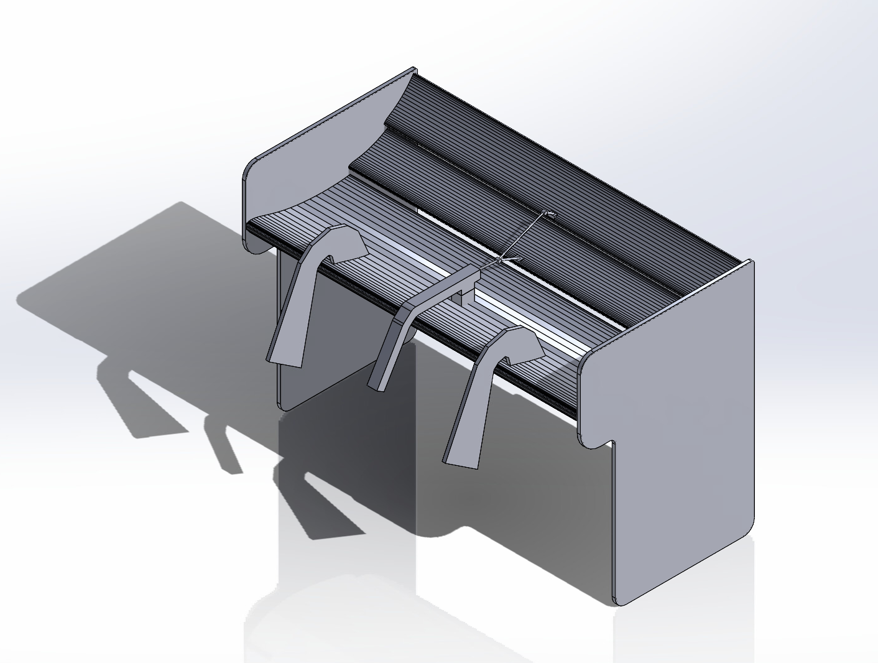
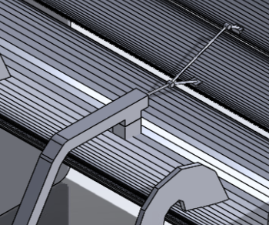
CAD of DRS rear wing
Pod pull actuator system
Endplate
Swan neck mounting

Slide 8
Actuator System
There are four main actuation types, which are electric, pneumatic, hydraulic, and mechanical.
•Hydraulic actuators can keep a high constant force and torque; however, the slow activation speeds and increased weight are a big downside.
•Pneumatic actuators are driven by air pressure rather than fluids, which means they are extremely fast, reliable, and consistent with linear motion. A disadvantage is that they can sometimes lose pressure due to excessive compression, which would decrease the effectiveness.
•Electric actuators provide extremely accurate control and positioning. This system is also requires minimal maintenance. However they are not explosion proof and are very sensitive to vibration.
•Mechanical actuators can be very cheap, however they contain many moving parts which are prone to wear. They are also heavier than the other options.

Slide 9
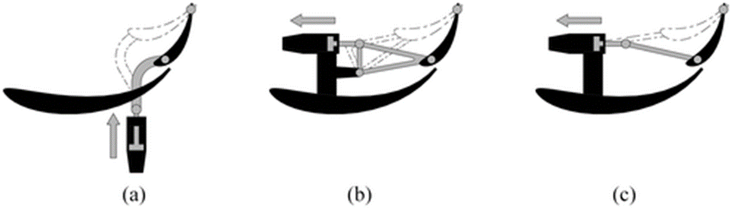
Actuator Type
•Push-up type Sits inside a vertical pillar below the mainplane. The advantages are that this system is simple and economic because it requires only a link between actuator and flap. The disadvantage is that it aerodynamic disturbance under the surface of the wing.
•Pod-rocker type The actuator and a part of the mechanism is included inside a pod, mounted over the mainplane. The advantages of this system is that it eliminates any aerodynamic disturbance under the mainplane. A disadvantage is that there are more moving parts.
•Pod-pull type Similar to the pod-rocker solution, but here the mechanism is simplified. The advantages of this system is that it eliminates any aerodynamic disturbance under the mainplane.

Slide 10
Improvements
Starting from Scratch
•More time spent on aerofoil analysis to test different shapes and gaps between the elements.
•Test different endplates.
•Test different actuator sizes.
For an EV
•Keep the weight low to improve agility.
•Make the wing taller without affecting the centre of gravity.
•Test different downforce levels.

Slide 11
Thank you for listening.
Questions?

